Slide 1
The application of CycDesigN in designing experiments for use in agriculture
Emlyn Williams
Statistical Support Network, ANU

Slide 2
Outline
Some history
CycDesigN 8.0
Overview
P-rep and spatial designs
Analysis

Slide 3
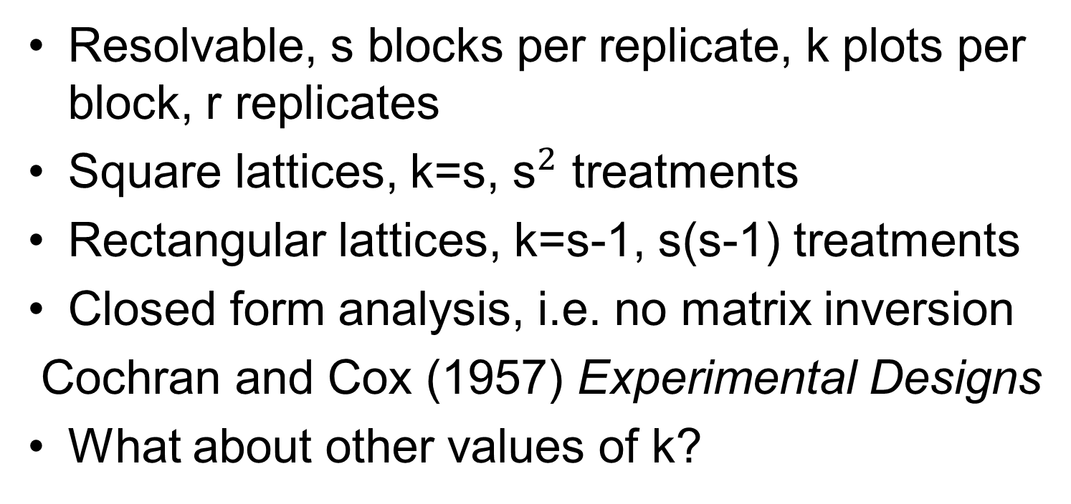
Square and Rectangular Lattice Designs
Resolvable, s blocks per replicate, k plots per block, r replicates
Square lattices, k=s, ${\text{s}}^{2}$ treatments
Rectangular lattices, k=s-1, s(s-1) treatments
Closed form analysis, i.e. no matrix inversion
Cochran and Cox (1957) Experimental Designs
What about other values of k?

Slide 4
Alpha Lattice Designs
Resolvable designs, s blocks per replicate, r replicates
k plots per block, k=2…s
Block
1 2 3 4 5
_____________________
1 2 3 4 5
6 7 8 9 10 Replicate 1
11 12 13 14 15
1 2 3 4 5
7 8 9 10 6 Replicate 2
13 14 15 11 12
Patterson and Williams (1976)
A new class of resolvable incomplete block designs
r=2, s=5, k=3
Alpha array
0 0
0 1
0 2

Slide 5
Development of Alpha Lattice Designs
Catalogue
Williams (1975)
Upper bounds for block designs
Williams and Patterson (1977)
Computer algorithm
Paterson and Patterson (1983)
Latinized and row-column designs
Williams (1986)
Alpha+ package
Williams and Talbot (1993)

Slide 6
Birth of CycDesigN
John and Williams (1995)
Cyclic and Computer Generated Designs
CycDesigN 1.0 (1997)
Resolvable and non-resolvable
Whitaker, Williams and John (1997)
CycDesigN 2.0 (2001)
Spatial (LV, AR)
CycDesigN 5.0 (2012)
CycXover, P-rep

Slide 7
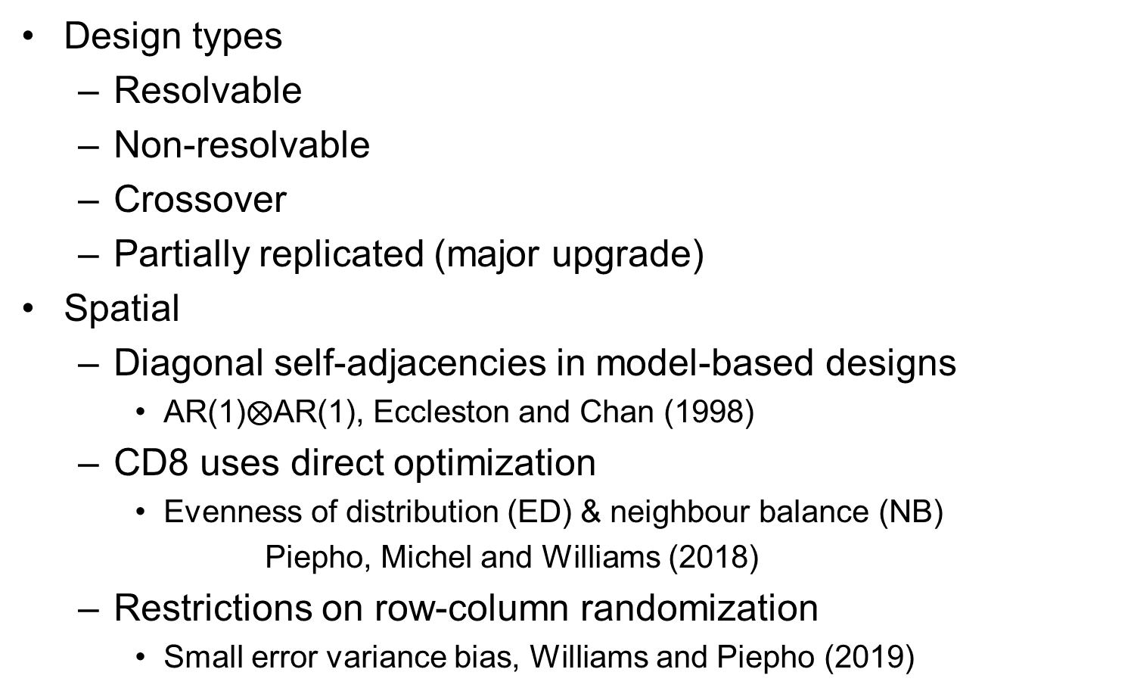
CycDesigN 8.0 (released September 2022)
Design types
Resolvable
Non-resolvable
Crossover
Partially replicated (major upgrade)
Spatial
Diagonal self-adjacencies in model-based designs
AR(1)$⨂$AR(1), Eccleston and Chan (1998)
CD8 uses direct optimization
Evenness of distribution (ED) & neighbour balance (NB)
Piepho, Michel and Williams (2018)
Restrictions on row-column randomization
Small error variance bias, Williams and Piepho (2019)

Slide 8
Latinized design for v=24, r=4, s=6, k=4
 |  | Column
 | Row | 1 | 2 | 3 | 4 | 5 | 6 |  | 1 | 2 | 3 | 4 | 5 | 6
 | 1 | 3 | 1 | 12 | 11 | 6 | 8 |  | 23 | 18 | 13 | 14 | 22 | 20
 | 2 | 10 | 24 | 9 | 5 | 23 | 18 |  | 19 | 2 | 8 | 6 | 17 | 4
Replicate 1 | 3 | 17 | 13 | 20 | 19 | 15 | 7 |  | 21 | 1 | 16 | 5 | 12 | 10 | Replicate 2
 | 4 | 14 | 4 | 2 | 22 | 16 | 21 |  | 3 | 15 | 9 | 7 | 24 | 11
 | 1 | 13 | 11 | 15 | 14 | 21 | 12 |  | 22 | 20 | 7 | 16 | 1 | 3
Replicate 3 | 2 | 22 | 6 | 4 | 18 | 9 | 3 |  | 8 | 24 | 23 | 11 | 14 | 2 | Replicate 4
 | 3 | 1 | 23 | 8 | 20 | 17 | 5 |  | 10 | 6 | 12 | 18 | 19 | 13
 | 4 | 7 | 2 | 19 | 24 | 10 | 16 |  | 15 | 21 | 4 | 17 | 9 | 5
Average efficiency factor=0.63

Slide 9
Latinized design for v=24, r=4, s=6, k=4
 |  | Column
 | Row | 1 | 2 | 3 | 4 | 5 | 6 |  | 1 | 2 | 3 | 4 | 5 | 6
 | 1 | 3 | 1 | 12 | 11 | 6 | 8 |  | 23 | 18 | 13 | 14 | 22 | 20
 | 2 | 10 | 24 | 9 | 5 | 23 | 18 |  | 19 | 2 | 8 | 6 | 17 | 4
Replicate 1 | 3 | 17 | 13 | 20 | 19 | 15 | 7 |  | 21 | 1 | 16 | 5 | 12 | 10 | Replicate 2
 | 4 | 14 | 4 | 2 | 22 | 16 | 21 |  | 3 | 15 | 9 | 7 | 24 | 11
 | 1 | 13 | 11 | 15 | 14 | 21 | 12 |  | 22 | 20 | 7 | 16 | 1 | 3
Replicate 3 | 2 | 22 | 6 | 4 | 18 | 9 | 3 |  | 8 | 24 | 23 | 11 | 14 | 2 | Replicate 4
 | 3 | 1 | 23 | 8 | 20 | 17 | 5 |  | 10 | 6 | 12 | 18 | 19 | 13
 | 4 | 7 | 2 | 19 | 24 | 10 | 16 |  | 15 | 21 | 4 | 17 | 9 | 5

Slide 10
Latinized design for v=24, r=4, s=6, k=4
 |  | Column
 | Row | 1 | 2 | 3 | 4 | 5 | 6 |  | 1 | 2 | 3 | 4 | 5 | 6
 | 1 | 3 | 1 | 12 | 11 | 6 | 8 |  | 23 | 18 | 13 | 14 | 22 | 20
 | 2 | 10 | 24 | 9 | 5 | 23 | 18 |  | 19 | 2 | 8 | 6 | 17 | 4
Replicate 1 | 3 | 17 | 13 | 20 | 19 | 15 | 7 |  | 21 | 1 | 16 | 5 | 12 | 10 | Replicate 2
 | 4 | 14 | 4 | 2 | 22 | 16 | 21 |  | 3 | 15 | 9 | 7 | 24 | 11
 | 1 | 13 | 11 | 15 | 14 | 21 | 12 |  | 22 | 20 | 7 | 16 | 1 | 3
Replicate 3 | 2 | 22 | 6 | 4 | 18 | 9 | 3 |  | 8 | 24 | 23 | 11 | 14 | 2 | Replicate 4
 | 3 | 1 | 23 | 8 | 20 | 17 | 5 |  | 10 | 6 | 12 | 18 | 19 | 13
 | 4 | 7 | 2 | 19 | 24 | 10 | 16 |  | 15 | 21 | 4 | 17 | 9 | 5

Slide 11
Spatial design for v=24, r=4, s=6, k=4
 |  | Column
 | Row | 1 | 2 | 3 | 4 | 5 | 6 |  | 1 | 2 | 3 | 4 | 5 | 6
 | 1 | 1 | 14 | 15 | 21 | 8 | 2 |  | 18 | 16 | 20 | 19 | 17 | 11
 | 2 | 23 | 6 | 13 | 12 | 22 | 17 |  | 3 | 10 | 15 | 2 | 9 | 7
Replicate 1 | 3 | 3 | 20 | 24 | 10 | 11 | 19 |  | 4 | 8 | 5 | 23 | 14 | 12 | Replicate 2
 | 4 | 16 | 7 | 4 | 18 | 9 | 5 |  | 21 | 6 | 22 | 24 | 13 | 1
 | 1 | 21 | 13 | 22 | 16 | 2 | 7 |  | 1 | 9 | 17 | 10 | 6 | 18
Replicate 3 | 2 | 5 | 18 | 1 | 24 | 12 | 6 |  | 19 | 23 | 7 | 15 | 4 | 22 | Replicate 4
 | 3 | 11 | 23 | 10 | 14 | 17 | 15 |  | 13 | 20 | 8 | 12 | 2 | 3
 | 4 | 19 | 8 | 9 | 20 | 4 | 3 |  | 16 | 21 | 24 | 5 | 11 | 14
Average efficiency factor=0.61

Slide 12
Part of the CD8 output
Latinized by columns
Number of long column groups = 2
Group 1 2 Replicates
Group 2 2 Replicates
Latinized by rows
Number of long row groups = 2
Group 1 2 Replicates
Group 2 2 Replicates
Spatial information
Spatial neighbours
None
Neighbour balance score (column) = 0
Neighbour balance score (row) = 0

Slide 13
Non-resolvable design for v=26, s=15, k=7
 | Column
Row | 1 | 2 | 3 | 4 | 5 | 6 | 7 | 8 | 9 | 10 | 11 | 12 | 13 | 14 | 15
1 | 24 | 7 | 4 | 3 | 5 | 23 | 6 | 21 | 18 | 15 | 25 | 2 | 19 | 16 | 8
2 | 6 | 1 | 11 | 12 | 22 | 19 | 18 | 15 | 7 | 3 | 20 | 9 | 8 | 14 | 13
3 | 10 | 17 | 20 | 25 | 19 | 5 | 2 | 9 | 26 | 22 | 23 | 1 | 12 | 6 | 14
4 | 23 | 8 | 6 | 18 | 4 | 9 | 15 | 1 | 14 | 26 | 3 | 24 | 21 | 17 | 25
5 | 13 | 21 | 25 | 19 | 24 | 16 | 17 | 10 | 22 | 1 | 9 | 11 | 26 | 7 | 4
6 | 8 | 20 | 26 | 13 | 18 | 15 | 10 | 12 | 2 | 16 | 7 | 5 | 11 | 24 | 9
7 | 22 | 5 | 16 | 17 | 20 | 14 | 11 | 4 | 21 | 13 | 10 | 3 | 23 | 12 | 2
Average efficiency factor=0.85

Slide 14
Non-resolvable design for v=26, s=15, k=7
 | Column
Row | 1 | 2 | 3 | 4 | 5 | 6 | 7 | 8 | 9 | 10 | 11 | 12 | 13 | 14 | 15
1 | 24 | 7 | 4 | 3 | 5 | 23 | 6 | 21 | 18 | 15 | 25 | 2 | 19 | 16 | 8
2 | 6 | 1 | 11 | 12 | 22 | 19 | 18 | 15 | 7 | 3 | 20 | 9 | 8 | 14 | 13
3 | 10 | 17 | 20 | 25 | 19 | 5 | 2 | 9 | 26 | 22 | 23 | 1 | 12 | 6 | 14
4 | 23 | 8 | 6 | 18 | 4 | 9 | 15 | 1 | 14 | 26 | 3 | 24 | 21 | 17 | 25
5 | 13 | 21 | 25 | 19 | 24 | 16 | 17 | 10 | 22 | 1 | 9 | 11 | 26 | 7 | 4
6 | 8 | 20 | 26 | 13 | 18 | 15 | 10 | 12 | 2 | 16 | 7 | 5 | 11 | 24 | 9
7 | 22 | 5 | 16 | 17 | 20 | 14 | 11 | 4 | 21 | 13 | 10 | 3 | 23 | 12 | 2

Slide 15
Non-resolvable design for v=26, s=15, k=7
 | Column
Row | 1 | 2 | 3 | 4 | 5 | 6 | 7 | 8 | 9 | 10 | 11 | 12 | 13 | 14 | 15
1 | 24 | 7 | 4 | 3 | 5 | 23 | 6 | 21 | 18 | 15 | 25 | 2 | 19 | 16 | 8
2 | 6 | 1 | 11 | 12 | 22 | 19 | 18 | 15 | 7 | 3 | 20 | 9 | 8 | 14 | 13
3 | 10 | 17 | 20 | 25 | 19 | 5 | 2 | 9 | 26 | 22 | 23 | 1 | 12 | 6 | 14
4 | 23 | 8 | 6 | 18 | 4 | 9 | 15 | 1 | 14 | 26 | 3 | 24 | 21 | 17 | 25
5 | 13 | 21 | 25 | 19 | 24 | 16 | 17 | 10 | 22 | 1 | 9 | 11 | 26 | 7 | 4
6 | 8 | 20 | 26 | 13 | 18 | 15 | 10 | 12 | 2 | 16 | 7 | 5 | 11 | 24 | 9
7 | 22 | 5 | 16 | 17 | 20 | 14 | 11 | 4 | 21 | 13 | 10 | 3 | 23 | 12 | 2

Slide 16
Non-resolvable design for v=26, s=15, k=7
 | Column
Row | 1 | 2 | 3 | 4 | 5 | 6 | 7 | 8 | 9 | 10 | 11 | 12 | 13 | 14 | 15
1 | 24 | 7 | 4 | 3 | 5 | 23 | 6 | 21 | 18 | 15 | 25 | 2 | 19 | 16 | 8
2 | 6 | 1 | 11 | 12 | 22 | 19 | 18 | 15 | 7 | 3 | 20 | 9 | 8 | 14 | 13
3 | 10 | 17 | 20 | 25 | 19 | 5 | 2 | 9 | 26 | 22 | 23 | 1 | 12 | 6 | 14
4 | 23 | 8 | 6 | 18 | 4 | 9 | 15 | 1 | 14 | 26 | 3 | 24 | 21 | 17 | 25
5 | 13 | 21 | 25 | 19 | 24 | 16 | 17 | 10 | 22 | 1 | 9 | 11 | 26 | 7 | 4
6 | 8 | 20 | 26 | 13 | 18 | 15 | 10 | 12 | 2 | 16 | 7 | 5 | 11 | 24 | 9
7 | 22 | 5 | 16 | 17 | 20 | 14 | 11 | 4 | 21 | 13 | 10 | 3 | 23 | 12 | 2

Slide 17
Spatial design for v=26, s=15, k=7
 | Column
Row | 1 | 2 | 3 | 4 | 5 | 6 | 7 | 8 | 9 | 10 | 11 | 12 | 13 | 14 | 15
1 | 15 | 24 | 3 | 9 | 13 | 8 | 18 | 10 | 21 | 5 | 17 | 11 | 25 | 2 | 16
2 | 21 | 6 | 4 | 25 | 26 | 22 | 23 | 2 | 20 | 1 | 16 | 14 | 7 | 18 | 24
3 | 19 | 8 | 16 | 17 | 1 | 15 | 14 | 11 | 4 | 13 | 23 | 12 | 22 | 10 | 5
4 | 13 | 5 | 7 | 21 | 12 | 3 | 25 | 6 | 17 | 18 | 15 | 20 | 26 | 1 | 9
5 | 12 | 26 | 23 | 10 | 11 | 20 | 24 | 7 | 16 | 19 | 2 | 6 | 8 | 17 | 3
6 | 11 | 1 | 18 | 14 | 6 | 19 | 26 | 15 | 8 | 22 | 24 | 9 | 21 | 4 | 23
7 | 25 | 20 | 22 | 2 | 4 | 16 | 5 | 9 | 12 | 10 | 7 | 3 | 13 | 19 | 14
Average efficiency factor=0.83

Slide 18
Part of the CD8 output
Design parameters
Number of treatments = 26
Number of rows = 7
Number of columns = 15
Number of replications = [Uneq]
Spatial information
Spatial neighbours
None
Neighbour balance score(row) = 0
Each replicated treatment spans at least
11 columns and 5 rows

Slide 19
Self adjacencies in spatial CD8
Type of self-adjacency | Description
1 | Single diagonal
2 | Knight move in column (NS) direction (two plots in column direction, one plot in row direction)
3 | Stretched knight move in column (NS) direction (three plots in column direction, one plot in row direction)
4 | Double diagonal
5 | Knight move in row (EW) direction (two plots in row direction, one plot in column direction)
6 | Stretched knight move in row (EW) direction (three plots in row direction, one plot in column direction

Slide 20
Single location p-rep design for 106 entries, 34 duplicates and one standard, replicated 10 times
 | Column
Row | 1 | 2 | 3 | 4 | 5 | 6 | 7 | 8 | 9 | 10 | 11 | 12 | 13 | 14 | 15
1 | 23 | 68 | 56 | 52 | 59 | 84 | S | 3 | 33 | 63 | 89 | 73 | 47 | 45 | 90
2 | 17 | 18 | 83 | 51 | 46 | 11 | 7 | 4 | 21 | 93 | 32 | 43 | 78 | 42 | S
3 | S | 9 | 24 | 28 | 25 | 1 | 30 | 37 | 86 | 76 | 81 | 106 | 104 | 35 | 44
4 | 20 | 61 | 75 | 92 | S | 100 | 45 | 8 | 60 | 69 | 85 | 87 | 40 | 67 | 99
5 | 21 | 15 | 57 | 65 | 50 | 36 | 26 | 97 | S | 56 | 58 | 5 | 10 | 72 | 19
6 | 76 | S | 62 | 101 | 71 | 14 | 90 | 34 | 27 | 68 | 22 | 54 | 39 | 11 | 29
7 | 98 | 85 | 13 | 89 | 67 | 16 | 70 | 103 | 48 | 2 | S | 66 | 94 | 30 | 51
8 | 37 | 88 | 49 | 96 | 40 | 31 | 41 | S | 17 | 74 | 75 | 50 | 55 | 12 | 3
9 | 104 | 42 | 6 | 39 | 95 | S | 102 | 53 | 61 | 57 | 79 | 18 | 62 | 52 | 26
10 | 105 | 63 | 54 | 82 | 66 | 10 | 64 | 44 | 80 | 38 | 77 | S | 1 | 91 | 13
Average efficiency factor=0.59

Slide 21
CycDesigN documentation
CycDesigN installation and activation guide
Quick start guide to CycDesigN
Quick start guide to p-rep designs in CycDesigN 8
CycDesigN 8 user guide (pdf of Help file)
https://cycdesign.kb.vsni.co.uk/knowledge-base/documentation

Slide 22
Analysis
Iterative analysis of gereralized lattice designs
Williams (1977)
Paterson and Silvey (1980)
Mixed models (Reml)
Many packages
Genstat
SAS
R
Predictmeans
ASReml-R

Slide 23
Analysis (p-rep) Vietnam clone trial, 4 standard types
Part of the CD8 – generated Genstat code
vcomponents [fixed=repl+conf+conf.standard; absorb=repl;\
cadjust=none] random=repl.row+repl.column+conv.clone
reml [print=model,components,means,effects,waldTests;\
pterms=repl+conf+conf.standard+conv.clone] v[1]
Part of the Genstat output
Fixed term Wald statistic n.d.f. F statistic d.d.f. F pr
repl 7.52 4 1.88 32.1 0.138
conf 71.04 1 71.04 254.6 <0.001
conf.standard 54.39 3 18.13 210.5 <0.001
conf/conv
Fixed term Wald statistic n.d.f. F statistic d.d.f. F pr
repl 7.52 4 1.88 32.1 0.138
conf 4.57 1 4.57 42.9 0.038
conf.standard 54.39 3 18.13 210.5 <0.001
just conf
Piepho, Williams and Fleck (2006)

Slide 24
Analysis (spatial)
Nearest neighbour (NN) analysis of field experiments
Wilkinson et al. (1983)
Second differences (and much more!)
A neighbour model for field experiments
Williams (1986)
Linear variance (LV), based on first differences
Efficiency of neighbour analysis for replicated variety
trials in Australia
Cullis and Gleeson (1989)
Autoregressive (AR1)

Slide 25
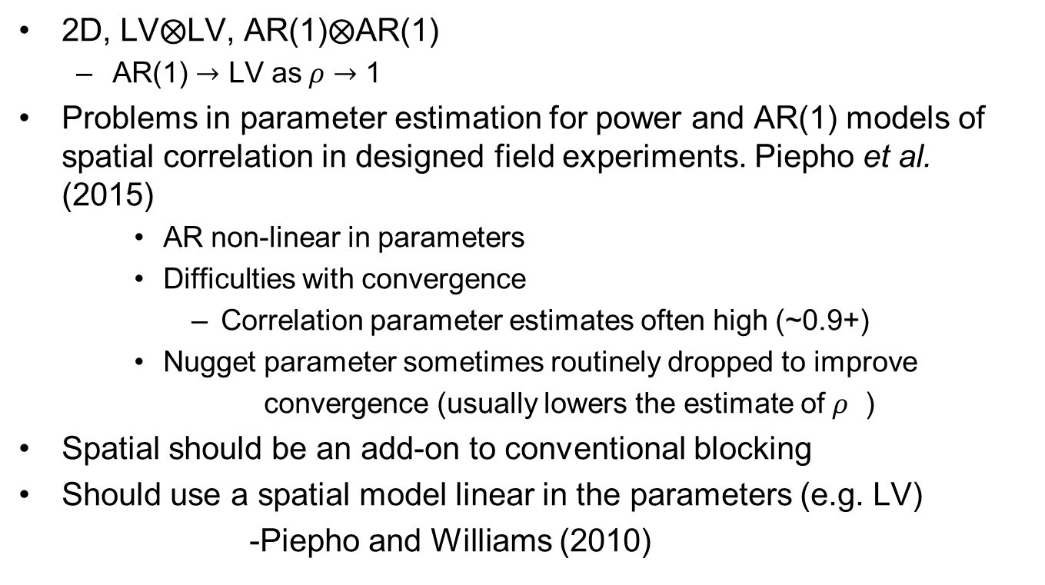
Spatial Analysis (developments)
2D, LV$⨂$LV, AR(1)$⨂$AR(1)
AR(1) $→$ LV as$ρ→$ 1
Problems in parameter estimation for power and AR(1) models of spatial correlation in designed field experiments. Piepho et al. (2015)
AR non-linear in parameters
Difficulties with convergence
Correlation parameter estimates often high (~0.9+)
Nugget parameter sometimes routinely dropped to improve
convergence (usually lowers the estimate of $ρ$ )
Spatial should be an add-on to conventional blocking
Should use a spatial model linear in the parameters (e.g. LV)
-Piepho and Williams (2010)

Slide 26
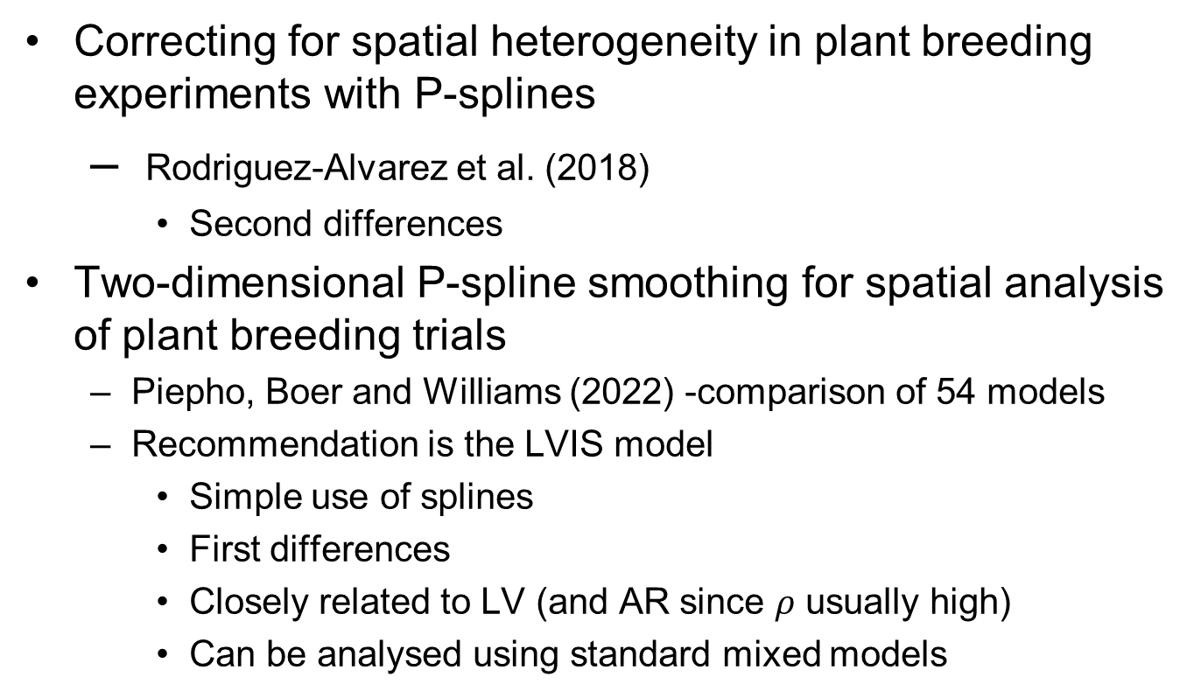
Spatial Analysis (spline models)
Correcting for spatial heterogeneity in plant breeding experiments with P-splines
Rodriguez-Alvarez et al. (2018)
Second differences
Two-dimensional P-spline smoothing for spatial analysis of plant breeding trials
Piepho, Boer and Williams (2022) -comparison of 54 models
Recommendation is the LVIS model
Simple use of splines
First differences
Closely related to LV (and AR since $ρ$ usually high)
Can be analysed using standard mixed models

